Slide 1
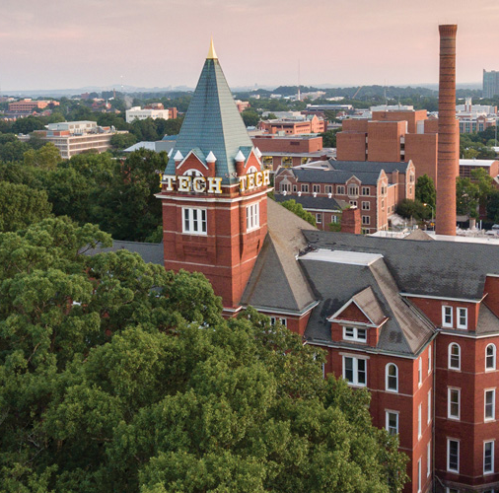

Meteorology
Division B
Georgia Tech Event Workshop Series 2024-25

Slide 2
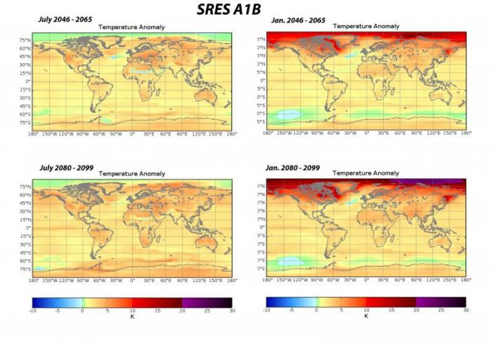
01
RULES SHEET
02
DIFFICULT TOPICS
03
COMMON QUESTIONS
04
TIPS FROM A VETERAN
05
OTHER FREE RESOURCES
Notes:
For Builds: Replace difficult topics with physical principles involved in the build and replace common questions with common designs

Slide 3
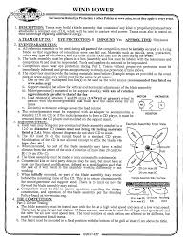
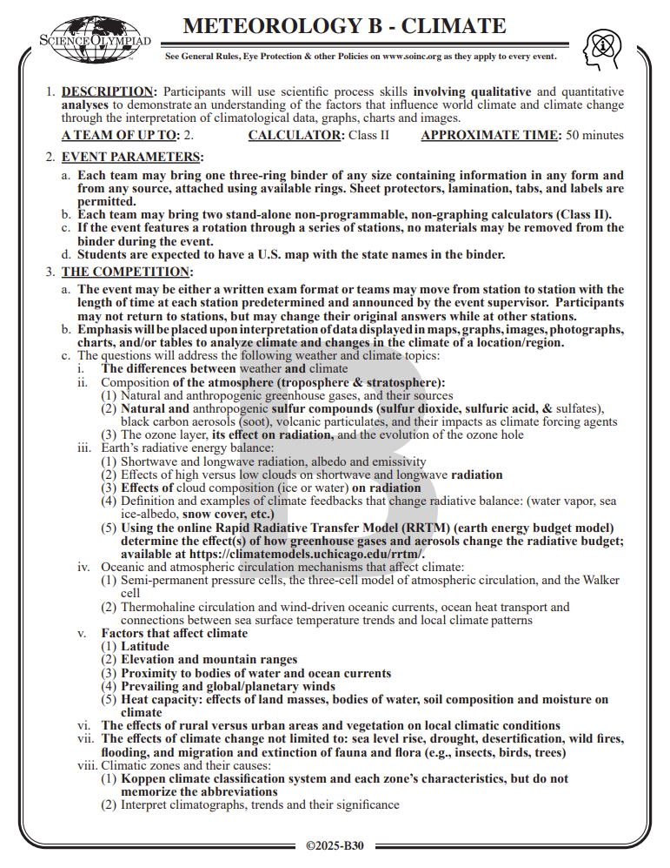
The Rules Sheet
Rules Sheet for Event
Topics
Atmospheric structure
Circulation patterns (ocean & air)
Energy balance
Climate zones
Human impacts
Climate change – Past, present, and future
Don’t Forget!
U.S. map with state names
UChicago RRTM
Notes:
Highlight key points from the rules sheet: DESIGN LOGS that basically grant free points, most tested-on topics, point distribution so that competitors know what to prioritize, allowed notes and equipment, etc.
I would suggest breaking down your notes into 6 broad sections, loosely based on those given in the rules. This should also help with organizing your study efforts.
Other content mentioned in the rules that might get forgotten are the U.S. map with state names -- it’s useful to have just in case -- and the Rapid Radiative Transfer Model. As a bit of a “practice exercise”, you can play around with each of the parameters one at a time (for example, how does the surface temperature affect the rate at which the planet gains/loses energy?) and try to understand how each of them affects the climate system.
https://climatemodels.uchicago.edu/rrtm/

Slide 4

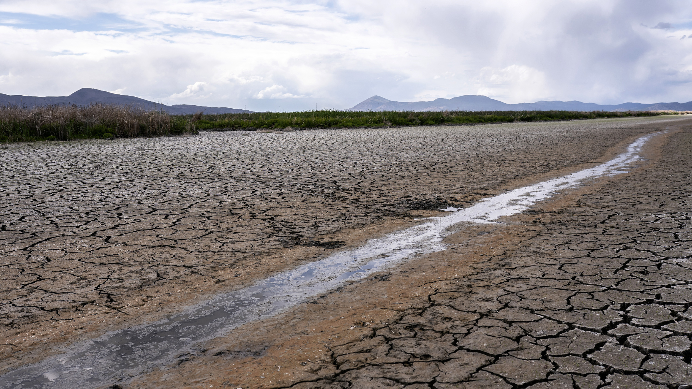
DIFFICULT TOPICS
Notes:
This section should focus on topics that are more math-based (harder to self-teach), concepts that come only usually up in college level courses, or concepts that you struggled with when you competed in this event

Slide 5
Topic 1: ENSO
What is the El Niño/Southern Oscillation (ENSO)?
Also called El Niño/La Niña
Recurring climate phenomenon
Changes sea surface temperature (SST), wind patterns, and precipitation around the Pacific Ocean
Occurs every 3-7 years
Warms or cools by 1-3 °C (2-6 °F)
Exact causes are unknown

Slide 6
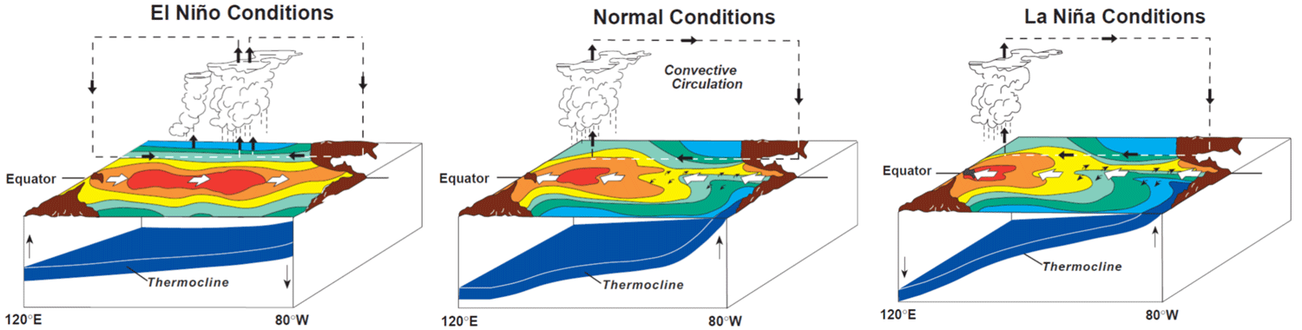
Topic 1: ENSO
During neutral phase:
SST is warmer in the west and cooler in the east
Equatorial winds blow east to west (trade winds)
Heavy precipitation in the western Pacific

Slide 7
Topic 1: ENSO
During an El Niño phase:
Eastern Pacific SST increases
Causes air to rise, changes pressure gradient
Pressure change disrupts trade winds, can even reverse direction
Less rain over western Pacific
More rain over central & eastern Pacific

Slide 8
Topic 1: ENSO
During an La Niña phase:
Eastern Pacific SST decreases
Difference between SST and air pressure in east vs west is even larger than normal
Trade winds are stronger when pressure difference is greater
More rain over western Pacific
Less rain over central & eastern Pacific

Slide 9
Topic 1: ENSO
There are many other changes associated with ENSO that were not covered here! It is a very big topic!
Notes:
Emphasize that competitors should seek out more information about ENSO and its changes while studying & making notes

Slide 10
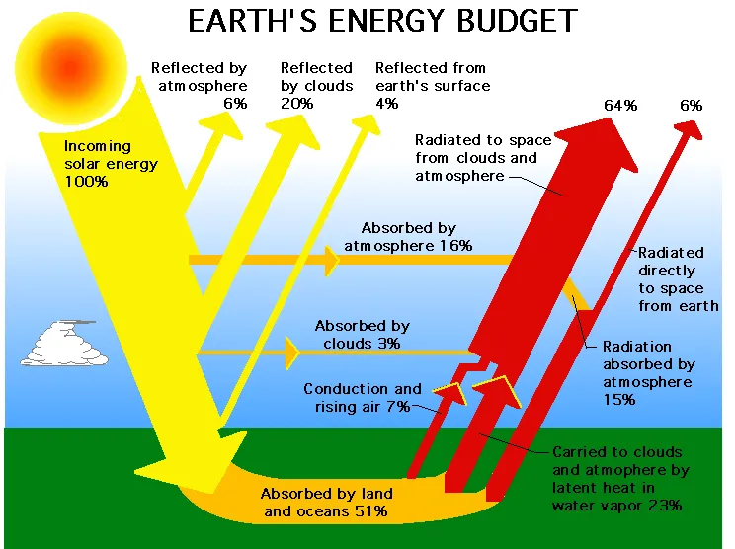
Topic 2: Energy Budget
Our planet takes in energy from the Sun and also emits its own energy
All energy involved in weather comes from the Sun
Sun emits shortwave energy (visible, UV)
Earth absorbs some energy and re-emits it as longwave radiation (infrared)
Earth’s longwave radiation is not the same as light that Earth reflects

Slide 11
Topic 2: Energy Budget
Albedo is how reflective a surface is
Albedo of 0 absorbs all incoming light
Albedo of 1 reflects all incoming light
Earth has an average albedo of 0.3
Therefore, about 30% of all sunlight is reflected back into space!
The rest is absorbed

Slide 12
Topic 2: Energy Budget
Absorbed energy is re-emitted as longwave radiation
Not the same as reflected energy
This energy is heading out to space
Some gases in the atmosphere absorb outgoing longwave radiation
Some energy is then re-emitted back to Earth’s surface as heat
This is the greenhouse effect

Slide 13
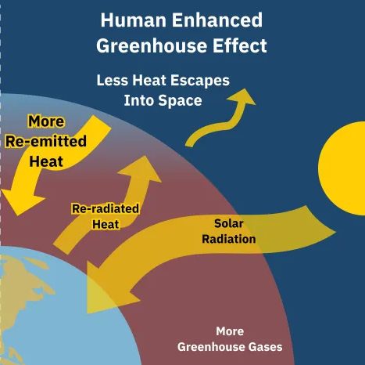
Topic 2: Energy Budget
The greenhouse effect is important for keeping the planet warm!
However, too much can be harmful
If Earth keeps more energy than it receives from the Sun, the planet will warm up
Common greenhouse gases include:
Carbon dioxide (CO₂)
Methane (CH₄)
Water (H₂O)
Nitrous oxide (N₂O)

Slide 14
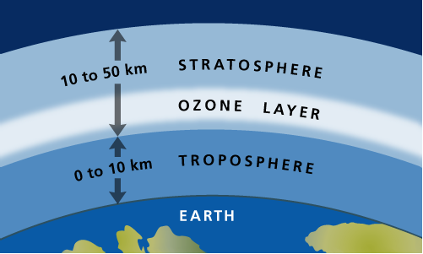
Topic 3: Ozone (O₃)
What is ozone?
Ozone is triatomic oxygen (O₃)
It is formed naturally in the stratosphere
Forms a protective layer that absorbs harmful UV radiation
Notes:
Feel free to add more topics and make sure that there are plenty of pictures/diagrams!

Slide 15
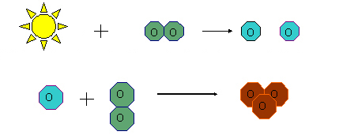
Topic 3: Ozone (O₃)
Stratospheric ozone is formed in the Chapman cycle
Ozone is formed when oxygen (O₂) is broken apart into two separate oxygen atoms (O) by UV radiation
O combines with O₂ to form ozone (O₃)
Notes:
Feel free to add more topics and make sure that there are plenty of pictures/diagrams!

Slide 16
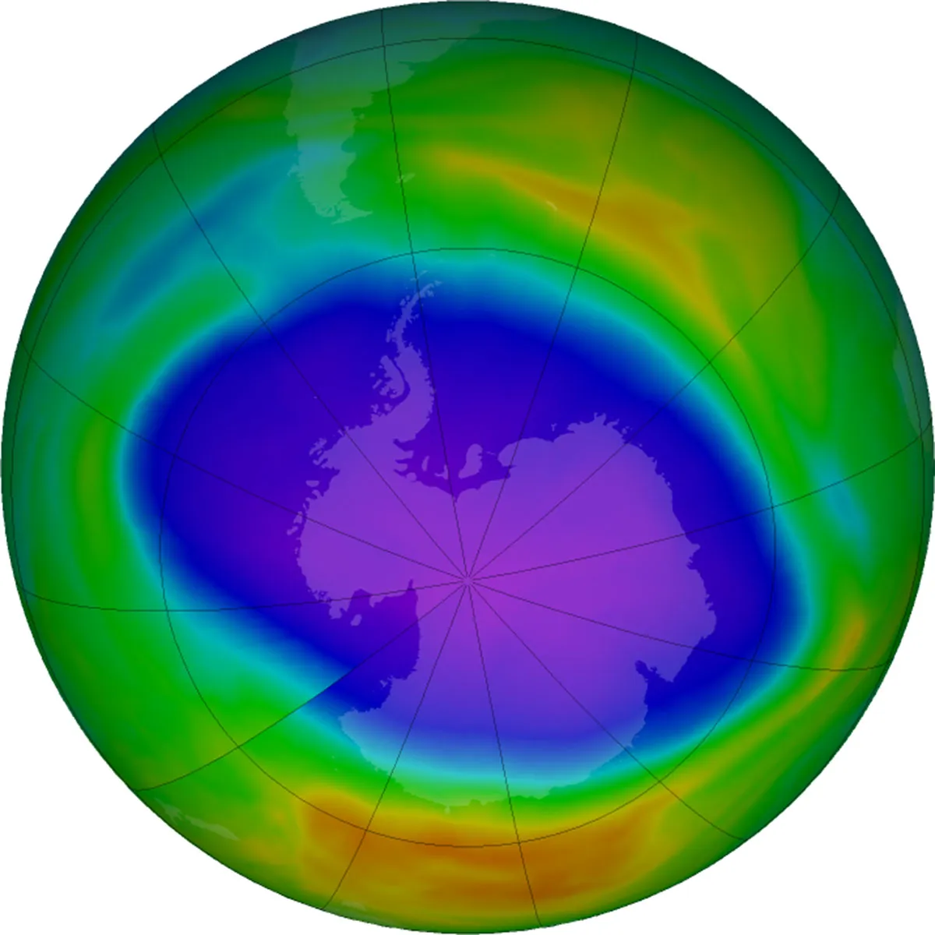
Topic 3: Ozone (O₃)
The Ozone hole is the most important application of ozone chemistry
Man-made chemicals called chlorofluorocarbons (CFCs) can destroy ozone
When CFCs are hit by UV radiation, a free chlorine atom (Cl) is released
Cl can break apart O₃ by stealing an oxygen atom
The Cl atom can be reused for a long time, destroying lots of ozone!
Ozone hole exposes us to dangerous UV rays
CFCs were regulated by the Montreal Protocol
Ozone hole is healing, but slowly
Notes:
Feel free to add more topics and make sure that there are plenty of pictures/diagrams!

Slide 17

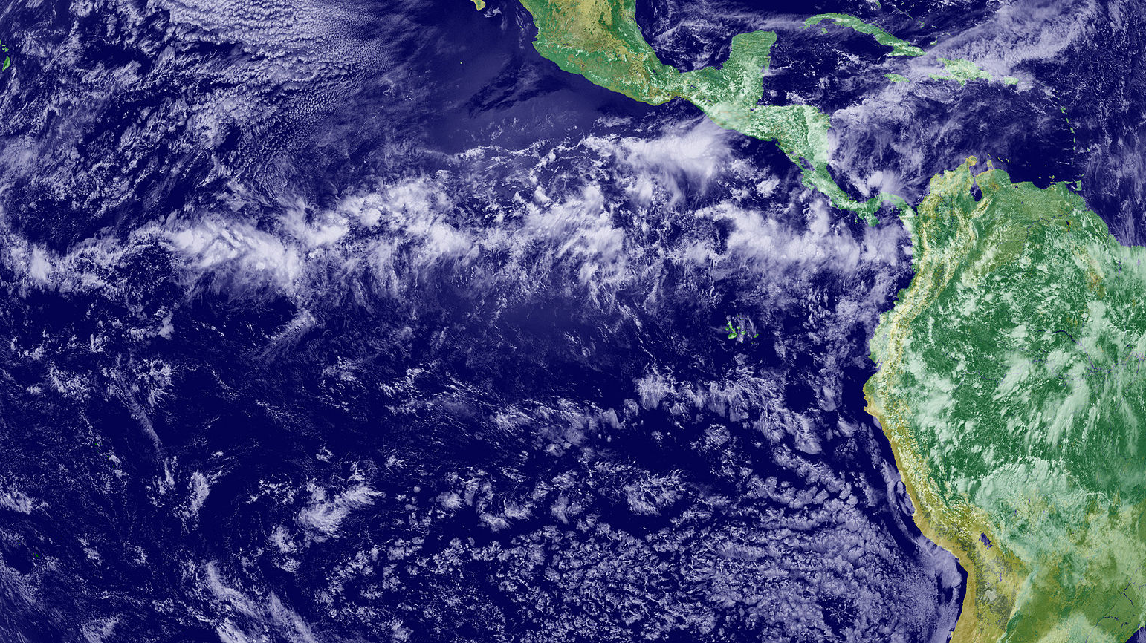
COMMON QUESTIONS
All of the following questions have been pulled from past YJI exams (which can be found on our website) or the Text Exchange on SciOly Wiki
Notes:
\

Slide 18
Question 1
What is the difference between weather and climate?
Notes:
Pull some questions from exams on the scioly wiki test exchange, first give attendees a couple minutes to read over them/work through them, then walk them through the answers. Try to get a mix of multiple choice and short answer or matching

Slide 19
Question 1
What is the difference between weather and climate?
Weather follows short-term changes in the atmosphere, while climate focuses on long-term averages (typically >30 years).
Notes:
Pull some questions from exams on the scioly wiki test exchange, first give attendees a couple minutes to read over them/work through them, then walk them through the answers. Try to get a mix of multiple choice and short answer or matching
By far one of the most common questions, and probably one of the most critical to know! Once you remember this, any question like this is basically free points.

Slide 20
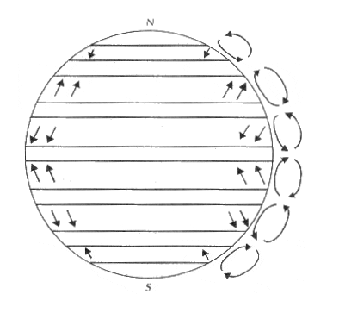
Question 2
Label circulation cells, pressure belts, and prevailing winds on a diagram:
Hadley cell
Ferrel cell
Polar cell
ITCZ
Subtropical high
Subpolar low
Trade winds
Westerlies
Polar easterlies
Notes:
Pull some questions from exams on the scioly wiki test exchange, first give attendees a couple minutes to read over them/work through them, then walk them through the answers

Slide 21
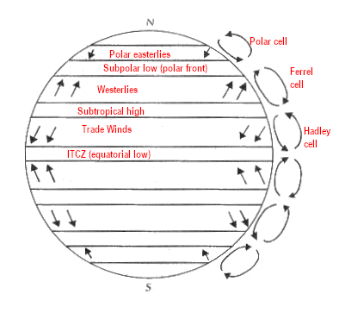
Question 2
Label circulation cells, pressure belts, and prevailing winds on a diagram:
Hadley cell
Ferrel cell
Polar cell
ITCZ
Subtropical high
Subpolar low
Trade winds
Westerlies
Polar easterlies
Notes:
Pull some questions from exams on the scioly wiki test exchange, first give attendees a couple minutes to read over them/work through them, then walk them through the answers
Diagram-labeling questions are very common, and this one in particular appears the most. You should absolutely add a version of this diagram into your notes!

Slide 22
Question 2
Label circulation cells, pressure belts, and prevailing winds on a diagram:
Which of these items is also called the Doldrums?
The Horse Latitudes?
Notes:
Pull some questions from exams on the scioly wiki test exchange, first give attendees a couple minutes to read over them/work through them, then walk them through the answers

Slide 23
Question 2
Label circulation cells, pressure belts, and prevailing winds on a diagram:
Which of these items is also called the Doldrums?
The Horse Latitudes?
Doldrums – ITCZ
Horse Latitudes – Subtropical high
Notes:
Pull some questions from exams on the scioly wiki test exchange, first give attendees a couple minutes to read over them/work through them, then walk them through the answers
I would also recommend including these alternate names in your notes!

Slide 24
Question 3
The sun emits [ shortwave / longwave ] radiation, while Earth emits [shortwave / longwave ] radiation.
Notes:
Pull some questions from exams on the scioly wiki test exchange, first give attendees a couple minutes to read over them/work through them, then walk them through the answers

Slide 25
Question 3
The sun emits [ shortwave / longwave ] radiation, while Earth emits [shortwave / longwave ] radiation.
Most of the light from the Sun is visible light and UV, which has a short wavelength (100-780 nm). Most of the light that Earth emits is infrared radiation, which has a longer wavelength (>780 nm).
Notes:
Pull some questions from exams on the scioly wiki test exchange, first give attendees a couple minutes to read over them/work through them, then walk them through the answers

Slide 26
Question 4
Which of the following generally has the highest albedo?
a) Fresh snow
b) Ocean
c) Grass
d) Concrete e) Forest
f) Clouds
Notes:
Pull some questions from exams on the scioly wiki test exchange, first give attendees a couple minutes to read over them/work through them, then walk them through the answers

Slide 27
Question 4
Which of the following generally has the highest albedo?
a) Fresh snow
b) Ocean
c) Grass
d) Concrete e) Forest
f) Clouds
Fresh snow has an albedo of 0.9, which means it reflects 90% of incoming light.
Notes:
Pull some questions from exams on the scioly wiki test exchange, first give attendees a couple minutes to read over them/work through them, then walk them through the answers

Slide 28
Question 4
Which of the following generally has the highest albedo?
a) Fresh snow
b) Ocean
c) Grass
d) Concrete e) Forest
f) Clouds
Follow-up: Which surface generally has the lowest albedo?
Notes:
Pull some questions from exams on the scioly wiki test exchange, first give attendees a couple minutes to read over them/work through them, then walk them through the answers

Slide 29
Question 4
Which of the following generally has the highest albedo?
a) Fresh snow
b) Ocean
c) Grass
d) Concrete e) Forest
f) Clouds
Follow-up: Which surface generally has the lowest albedo?
The ocean has an albedo of around 0.1, meaning it absorbs 90% of incoming light.
Notes:
Pull some questions from exams on the scioly wiki test exchange, first give attendees a couple minutes to read over them/work through them, then walk them through the answers

Slide 30
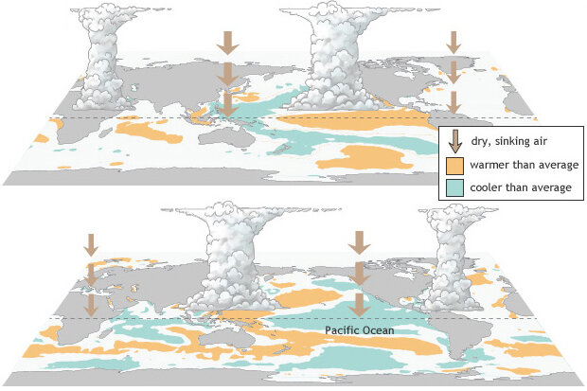
Question 5
Which diagram represents El Niño, and which diagram represents La Niña?
Notes:
Pull some questions from exams on the scioly wiki test exchange, first give attendees a couple minutes to read over them/work through them, then walk them through the answers

Slide 31
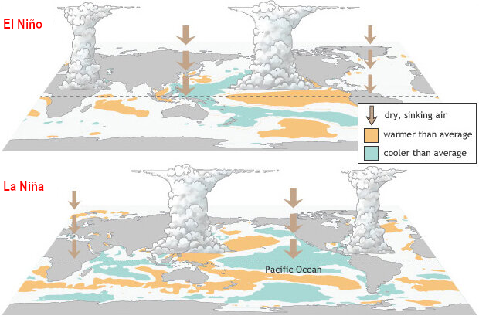
Question 5
Which diagram represents El Niño, and which diagram represents La Niña?
El Niño:
Warmer SST
↑ rain in east Pacific
↓ rain in west Pacific
La Nina:
Cooler SST
↓ rain in east Pacific
↑ rain in west Pacific
Notes:
Pull some questions from exams on the scioly wiki test exchange, first give attendees a couple minutes to read over them/work through them, then walk them through the answers
Refer back to ENSO slides if clarification is needed

Slide 32
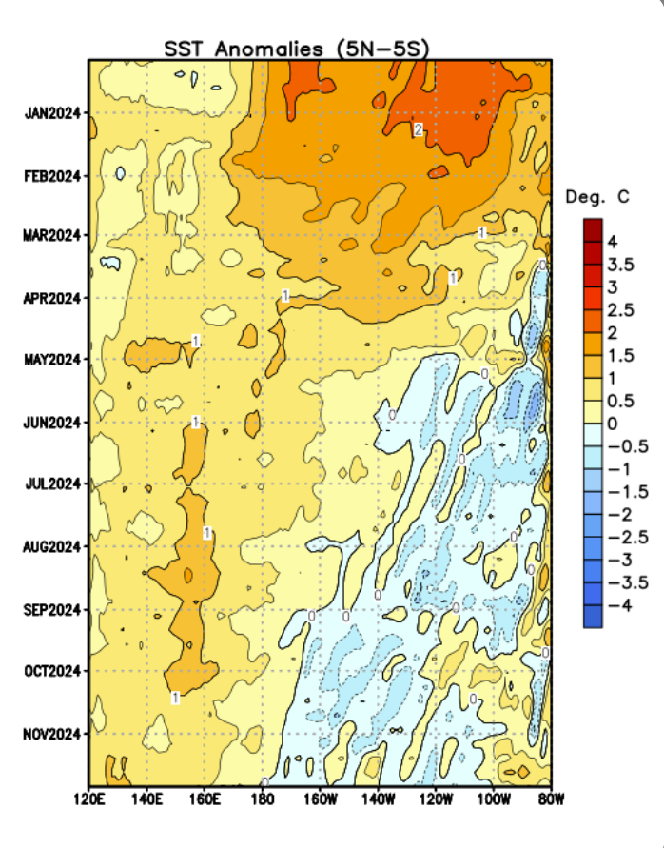
Question 6
What phase of ENSO are we currently in? What phase is predicted to occur next?
Notes:
Pull some questions from exams on the scioly wiki test exchange, first give attendees a couple minutes to read over them/work through them, then walk them through the answers

Slide 33
Question 6
What phase of ENSO are we currently in? What phase is predicted to occur next?
Current – neutral
Upcoming – La Niña
SSTs are close to average (SST anomaly is close to 0).
Overall trend of decreasing SST, suggesting La Niña.
Notes:
Pull some questions from exams on the scioly wiki test exchange, first give attendees a couple minutes to read over them/work through them, then walk them through the answers
This graph depicts the change in Pacific SST at the equator over the course of 2024. As one moves from top to bottom, the average SST is decreasing in the eastern Pacific. However, most of the anomaly (difference from average) is within about 1 deg. C in both directions, so we are currently still in a neutral phase.

Slide 34
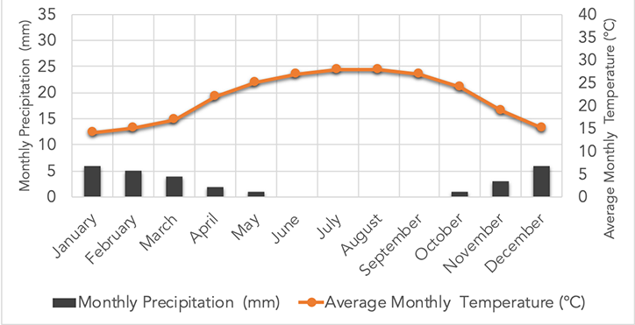
Question 7
What type of environment would produce this climatograph?
Notes:
Pull some questions from exams on the scioly wiki test exchange, first give attendees a couple minutes to read over them/work through them, then walk them through the answers

Slide 35
Question 7
What type of environment would produce this climatograph?
Hot desert
(Köppen - BWh)
Defined by
low rainfall and
high temperature
Notes:
Pull some questions from exams on the scioly wiki test exchange, first give attendees a couple minutes to read over them/work through them, then walk them through the answers
Note!! Not all deserts are hot!
Although competitors are not expected to memorize Köppen climate classifications, they should be able to match different climate zones to climatographs. I recommend keeping a table of the climate zones and a description of their temperature & precipitation patterns

Slide 36
Tips from a Veteran
If you get stuck on a tough conceptual question, try to break it into the core concepts
For example, the direction of flow is useful for questions that involve air or ocean circulation
Organize your notes! Being able to know exactly where to look for information will save valuable time
Learn vocabulary – a lot of questions will use specific climatology terms!
Be careful when using past tests to study because Meteorology rotates topics, so not all of them have the right content!
Notes:
Use this section to talk about any strategies you used to navigate the event when you competed. For example, how did you manage your time, how did you organize your notes, how did you split topics up between you and your partner, etc.?

Slide 37
Additional Resources
NOAA JetStream
Introduction to Climate Science
SUBWAY STATIONS
UIUC Online Meteorology Guide
NASA Climate Change
Yes, Saturn is the ringed one. This planet is a gas giant, and it’s composed mostly of hydrogen and helium
Notes:
Here, you can link or mention any online or book resources that helped you in this event when you were a competitor. Try to avoid general resources like scioly wiki, because they probably already are familiar with it.
NOAA Sites:
https://www.noaa.gov/jetstream - Excellent, well-organized content on all things atmosphere. The site is more geared towards short-term weather rather than climate, but still has many useful resources.
Other NOAA & related sites that are worth checking out
https://oceanservice.noaa.gov/education/for-students.html
https://www.climate.gov
Textbook:
https://open.oregonstate.education/climatechange/
It’s a wonderful, free textbook that is easier to digest than most college-level textbooks. I would focus primarily on Chapters 1, 2 and 6, as they are the most relevant to the current event topic while keeping the difficult, high-level terminology to a minimum.
UIUC Meteorology http://ww2010.atmos.uiuc.edu/(Gh)/guides/mtr/home.rxml
The site may be slightly outdated, but it generally provides very clear, simple explanations. However, it is not as well-suited to the Climate topic as it focuses more on Weather than Climate. Good for learning about ENSO.
NASA
https://science.nasa.gov/climate-change/ and other NASA sites, they have wonderful data, graphs, charts, etc. for visualizing climate change.

Slide 38
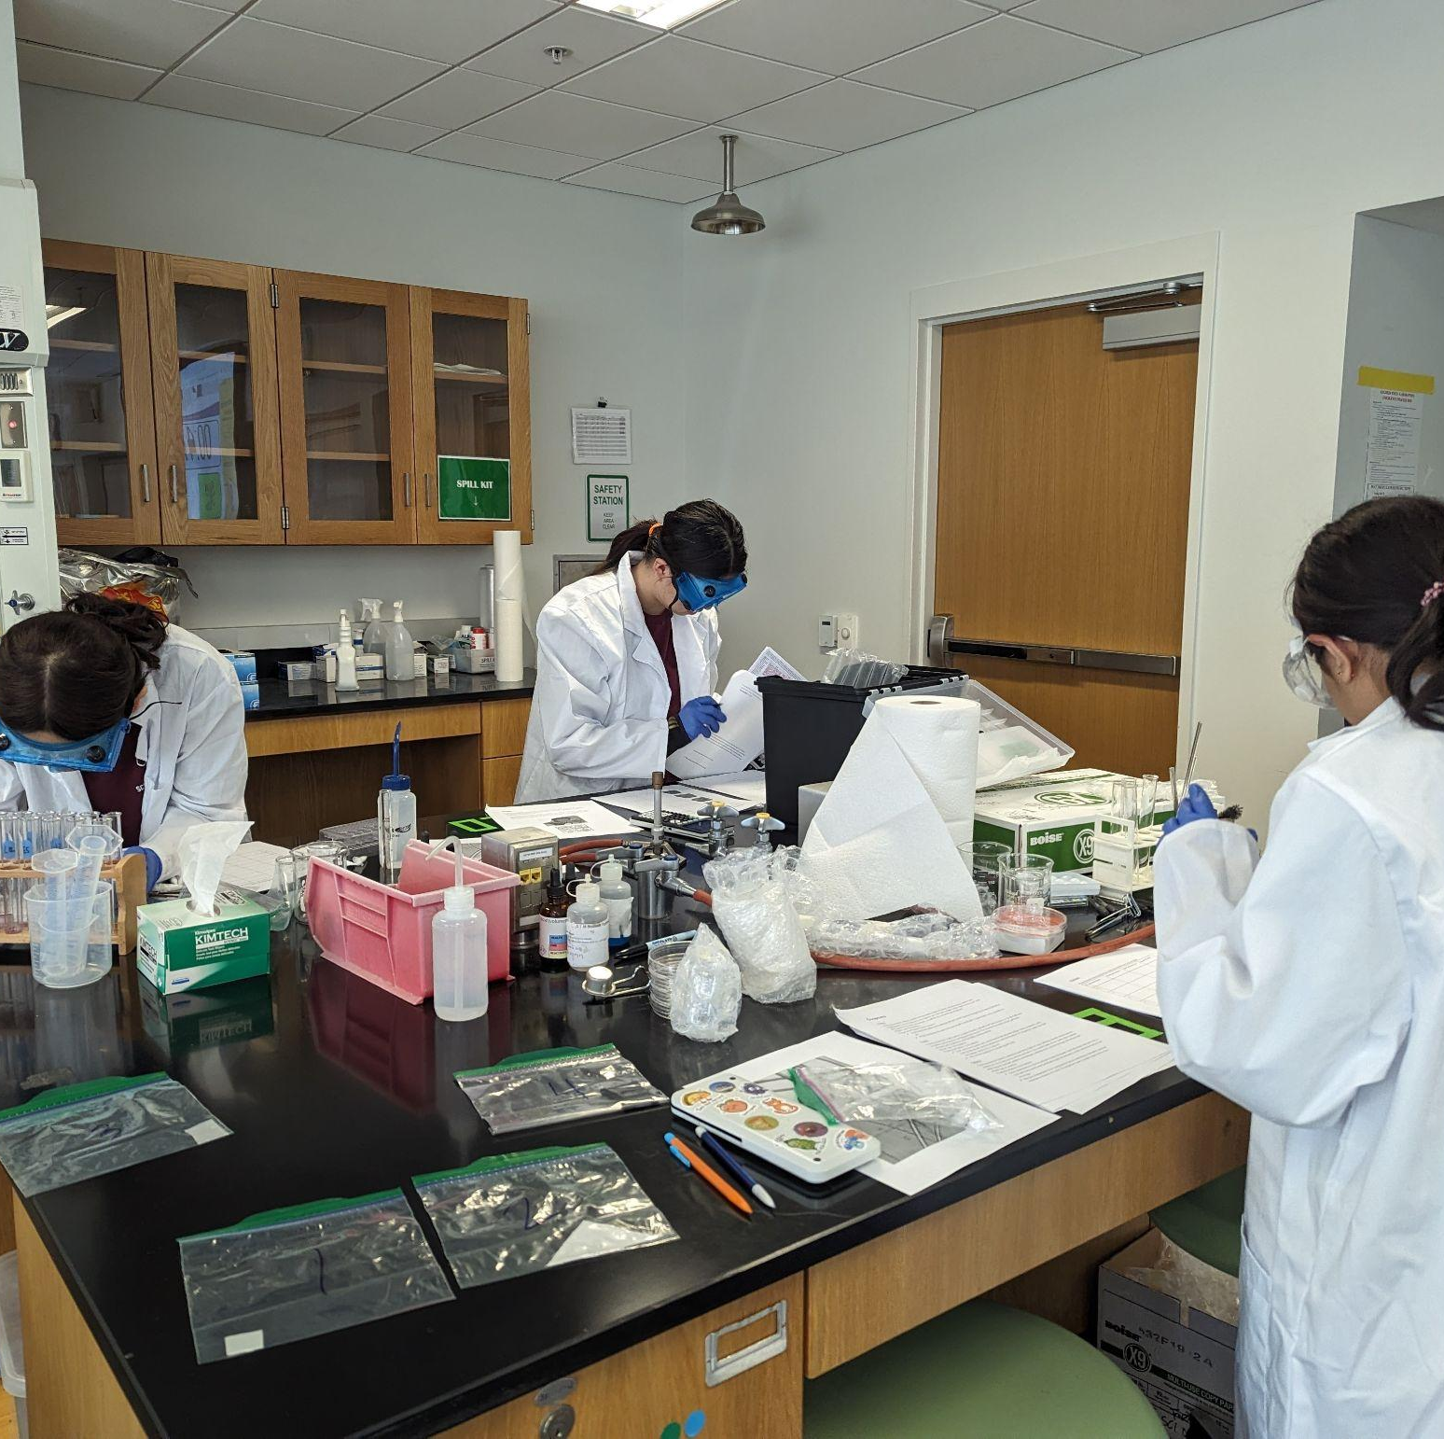
THANKS!
Notes:
(replace picture with a picture from one of our tournaments)

